Slide 1
Classification Algorithms
Logistic Regression

Slide 2
What is Classification?
Classification is a supervised Machine Learning technique that helps in predicting categorical or discrete (non-continuous) outputs.
Classification algorithms can be used to categorize/classify instances or samples.
For example, whether a mail is a spam or a transaction is fraudulent.

Slide 3
Examples of classification problems
Email spam or not spam,
Online transactions Fraud or not Fraud,
Tumor Malignant or Benign,
Customer Churn Prediction:
Predicting whether a customer will stop using a service,
Credit Scoring:
Estimating the probability of a customer defaulting on a loan.
Predicting the probability of a patient having a certain disease based on symptoms and test results.

Slide 4
Logistic Regression
Logistic regression is a widely used statistical method in machine learning for binary classification tasks, where the goal is to predict the probability that an instance belongs to one of two classes.
Logistic regression is a classification algorithm, used when the value of the target variable is categorical in nature. Logistic regression is most commonly used when the data in question has binary output, i.e either a 0 or 1.
Remember that classification tasks have discrete categories, unlike regressions tasks.
Notes:
Despite its name, logistic regression is not actually a regression algorithm, but it is a classification algorithm.

Slide 5
Logistic Regression
Logistic regression is a classification algorithm used to assign observations to a discrete set of classes.
Consider a coronary heart disease dataset which lists the age in years ('age') and the presence/absence of evidence of significant coronary heart disease ('chd') for 100 patients.

Slide 6
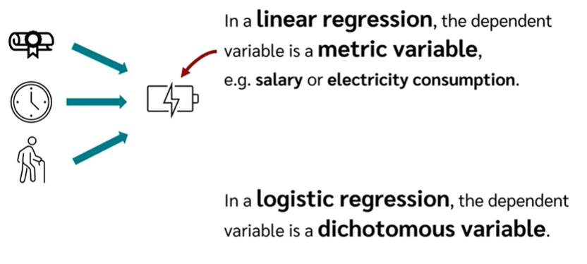
Dichotomous variable have only two values like yes or no, 0 or 1

Slide 7
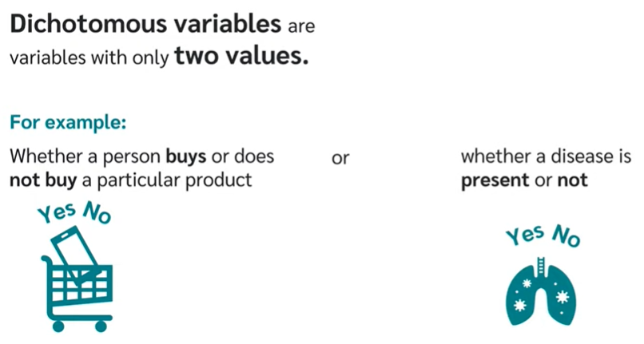

Slide 8
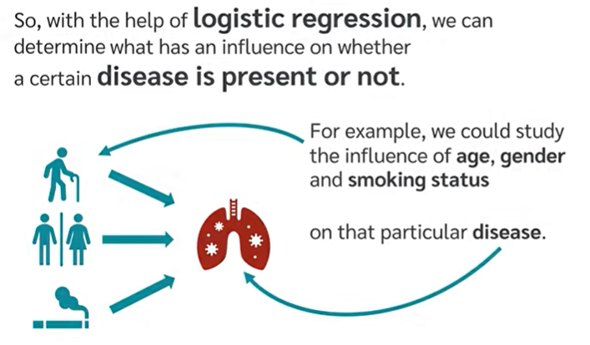
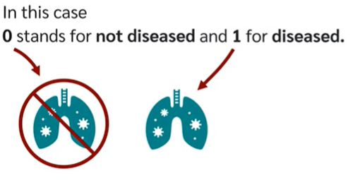
Logistic Regression

Slide 9
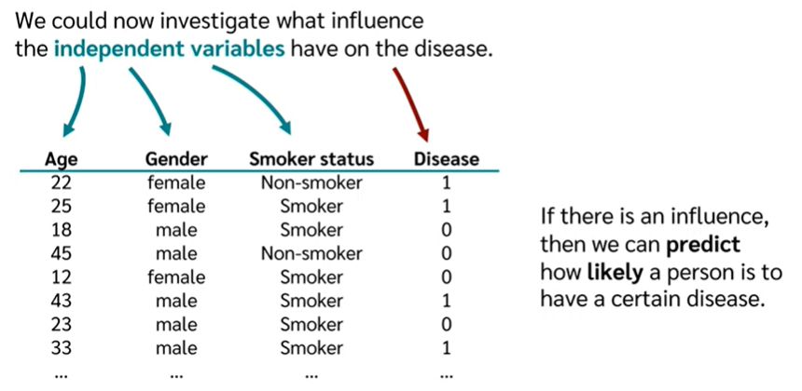

Slide 10
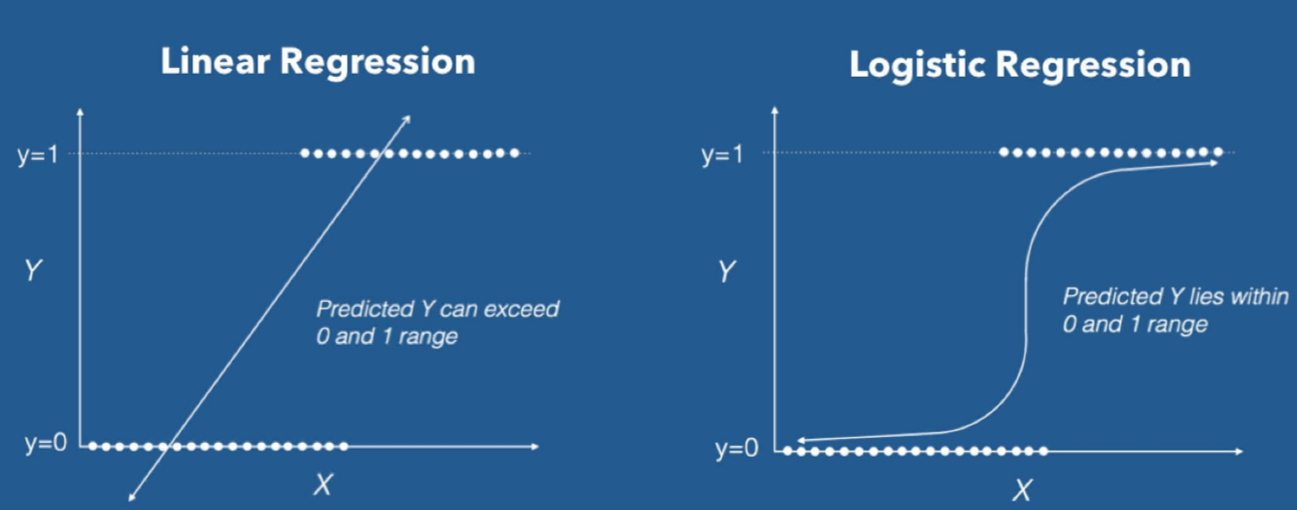
Logistic regression transforms its output using the logistic sigmoid function to return a probability value.
Logistic Regression uses a more complex cost function, this cost function can be defined as the ‘Sigmoid function’ or also known as the ‘logistic function’ instead of a linear function.

Slide 11
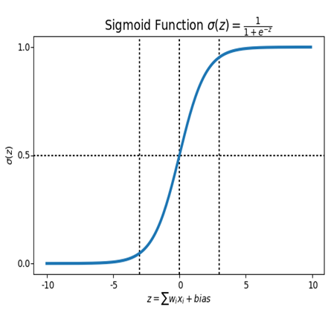
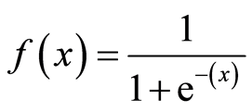
What is the Sigmoid Function?
In order to map predicted values to probabilities, we use the Sigmoid function. The function maps any real value into another value between 0 and 1.
In machine learning, we use sigmoid to map predictions to probabilities.
Formula of a sigmoid function | Image: Analytics India Magazine

Slide 12
Linear regression Vs Logistic regression
Linear regression models are used to identify the relationship between a continuous dependent variable and one or more independent variables.
When there is only one independent variable and one dependent variable, it is known as simple linear regression, but as the number of independent variables increases, it is referred to as multiple linear regression.
For each type of linear regression, it seeks to plot a line of best fit through a set of data points, which is typically calculated using the least squares method.
Logistic regression is used to estimate the relationship between a categorical dependent variable and one or more independent variables.
A categorical variable can be true or false, yes or no, 1 or 0, etc.
The unit of measure also differs from linear regression as it produces a probability, but the logit function transforms the S-curve into straight line.

Slide 13
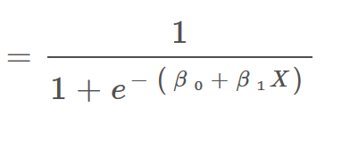
When using linear regression
Z = β₀ + β₁X
For logistic regression we are going to modify it a little bit i.e.
σ(Z)
will give values between 0 and 1.

Slide 14
Decision Boundary
We expect our classifier to give us a set of outputs or classes based on probability when we pass the inputs through a prediction function and returns a probability score between 0 and 1.
For Example, We have 2 classes, let’s take them like diseased and not diseassed(1 — diseased , 0 — not diseassed).
We basically decide with a threshold value above which we classify values into Class 1 and of the value goes below the threshold then we classify it in Class 2.

Slide 15
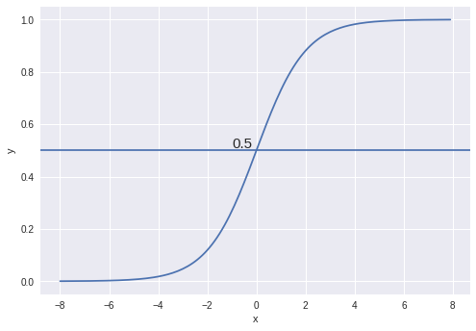
As shown in the above graph we have chosen the threshold as 0.5,
if the prediction function returned a value of 0.7 then we would classify this observation as Class 1(diseassed). If our prediction returned a value of 0.2 then we would classify the observation as Class 2(not diseassed).

Slide 16
Performance Measures
Evaluate the model's performance on training and test data using 'accuracy' measure.
Accuracy = no. of correct predictions /
total predictions
Precision : The precision for a class A indicates how accurate the model is in identifying class A.
Recall : The recall for a class A indicates how good the model is in fetching/retrieving instances of class A.
F1-score: is the harmonic mean of precision and recall

Slide 17
Measuring Model Performance using Confusion Matrix

Slide 18
Logistic regression can be classified as:
Based on the number of categories, Logistic regression can be classified as:
binomial: target variable can have only 2 possible types: “0” or “1” which may represent “win” vs “loss”, “pass” vs “fail”, “dead” vs “alive”, etc.
multinomial: target variable can have 3 or more possible types which are not ordered(i.e. types have no quantitative significance) like “disease A” vs “disease B” vs “disease C”.
ordinal: it deals with target variables with ordered categories. For example, a test score can be categorized as:“very poor”, “poor”, “good”, “very good”. Here, each category can be given a score like 0, 1, 2, 3.

Slide 19
SVM Example
https://scikit-learn.org/stable/auto_examples/classification/plot_digits_classification.html#sphx-glr-auto-examples-classification-plot-digits-classification-py

